Slide 1

ALTRUISTIC E-COMMERCE
PORTAL
Supervisor:
Mr. Amir Khan
Technical Trainer
Group members:
Akshita Saxena-181500066
Ashita Goyal-181500144
Bharti Gautam-181500192
Naina Agarwal-181500408
Nandani Bansal-181500413
Department of Computer Engineering and Applications
GLA University, Mathura
Uttar Pradesh, India

Slide 2
Overview Of Presentation:
Introduction
Motivation
Objective
Hardware And Software Requirement
Tools and Languages
Implementation and user interface
Benefits of the proposed work
User Interface
Source code and Google Drive link
References

Slide 3
Introduction
This project is aimed at developing an online static website for an E-commerce store which can be used by people to list their business on the website and will also provide customers to buy the products directly from the store.
The website is based on HTML, CSS, Bootstrap, JavaScript and React.
Our website will contain a Homepage where all the basic information about the store and details of the products will be available. This site is easy to operate and user friendly.
It will eventually help local businesses to increase their profits and people to buy the goods from the comfort of their homes.

Slide 4
OBJECTIVE
The objective of this project is to create an e-commerce web portal which would allow product information to be updated securely using a system.
This would permit rural communities to make their wares available to the rest of the world via the World Wide Web.
This web portal will allow local organizations and start-ups to start their businesses and reach out the market.

Slide 5
Motivation
Online store owners are always eager to know how to increase traffic on their e-commerce sites and how to increase their profits to earn more revenues. So E-commerce drives, profitable growth by expanding customer reach, reducing cost to serve and creating differentiated customer experiences.
This website encourages local businesses to create their online store and supports them to run their business to grow.

Slide 6
Hardware And Software Requirements
Hardware:
Processor :Intel i5
RAM : 8 GB
Hard disk : 256GB
Software:
Macintosh /Microsoft Windows /Linux
Virtual Studio Code or any other text editor
Chrome or any other browser

Slide 7
Languages used
HTML
CSS
Bootstrap
Java Script
React

Slide 8

Implementation and User Interface
This project is implemented by the help of Visual Code.
The user interface design was one of the core tasks in this project. The aim of UI design is to make the application to be accepted and used easily by.

Slide 9
Benefits of the proposed work
• Saves time of customers in quickly viewing various items on E-Commerce portal.
• The ability to view and purchase items anytime, from anywhere with Internet access.
• Provides the information about resort facilities.
• User friendly interface.
• No Convenience fees.
• Total features of E-Commerce Website are accessible.
• Easy to use and simple to understand.
• Quick and save lots of time.

Slide 10
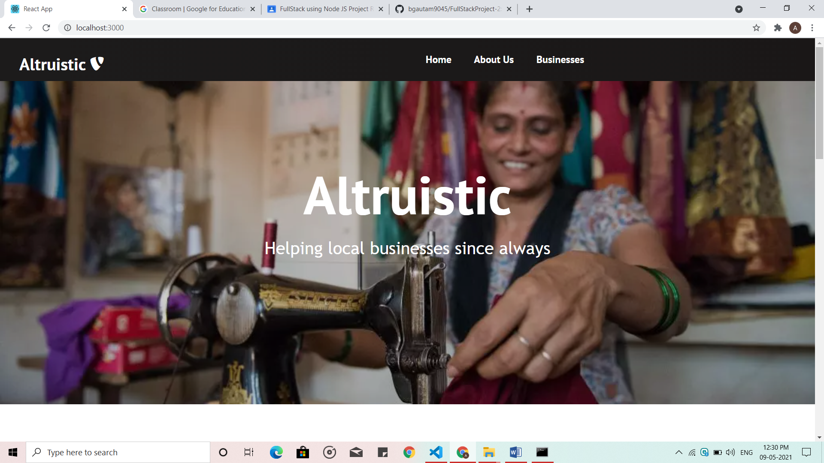
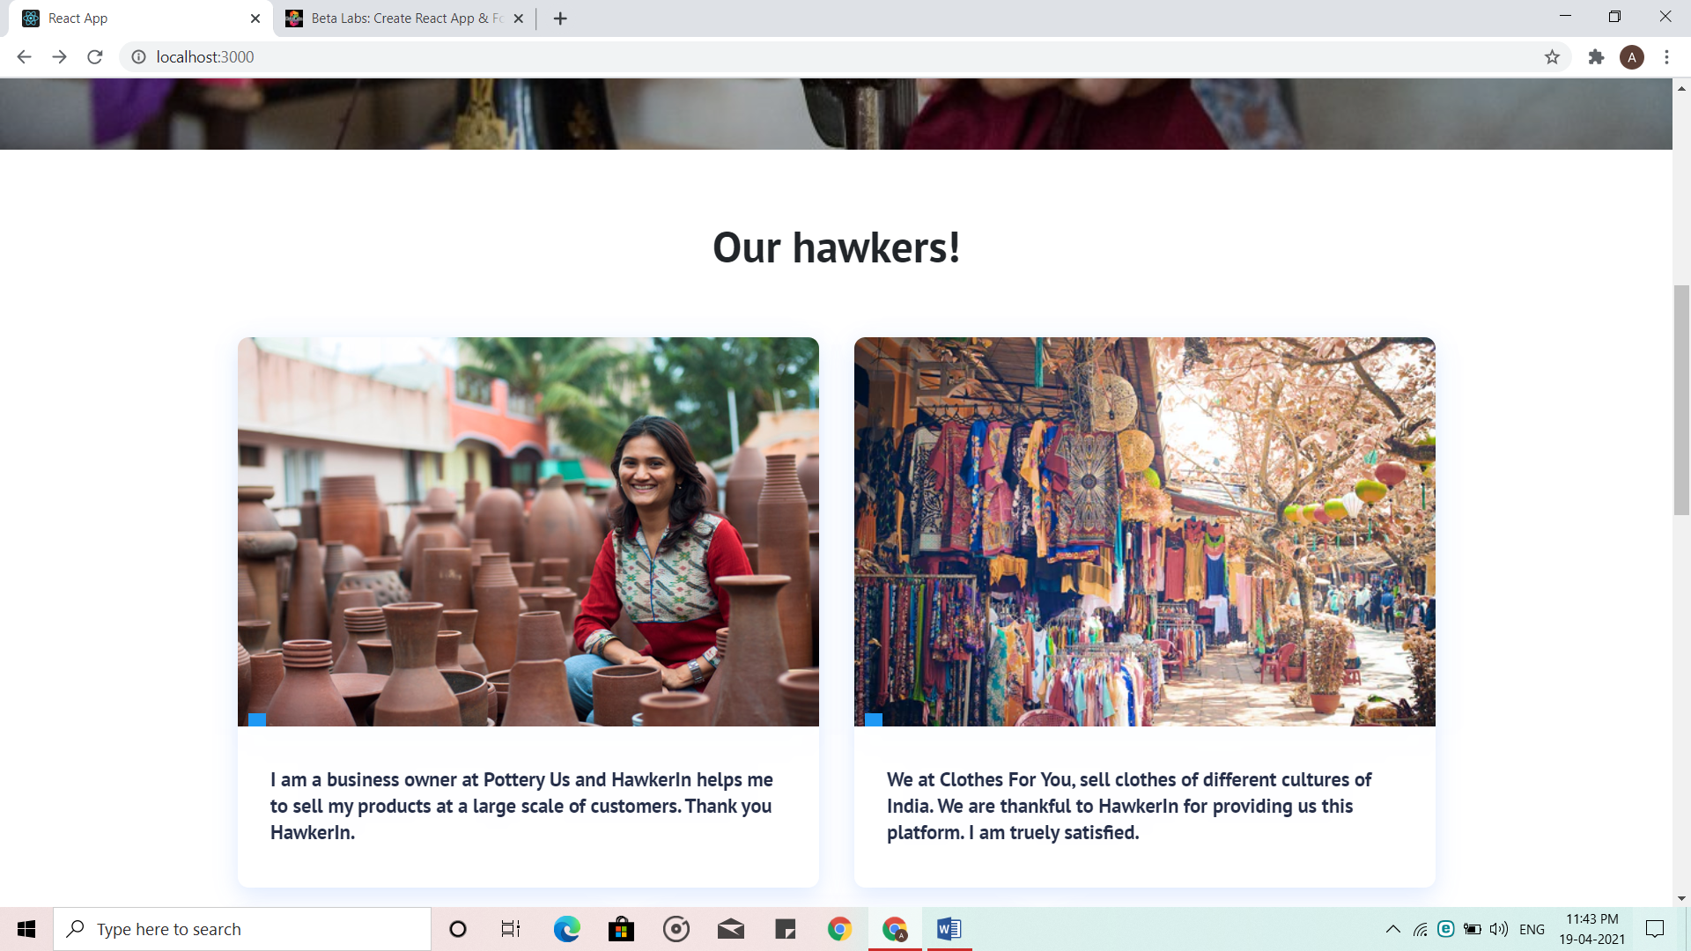
User Interface
HOME PAGE

Slide 11
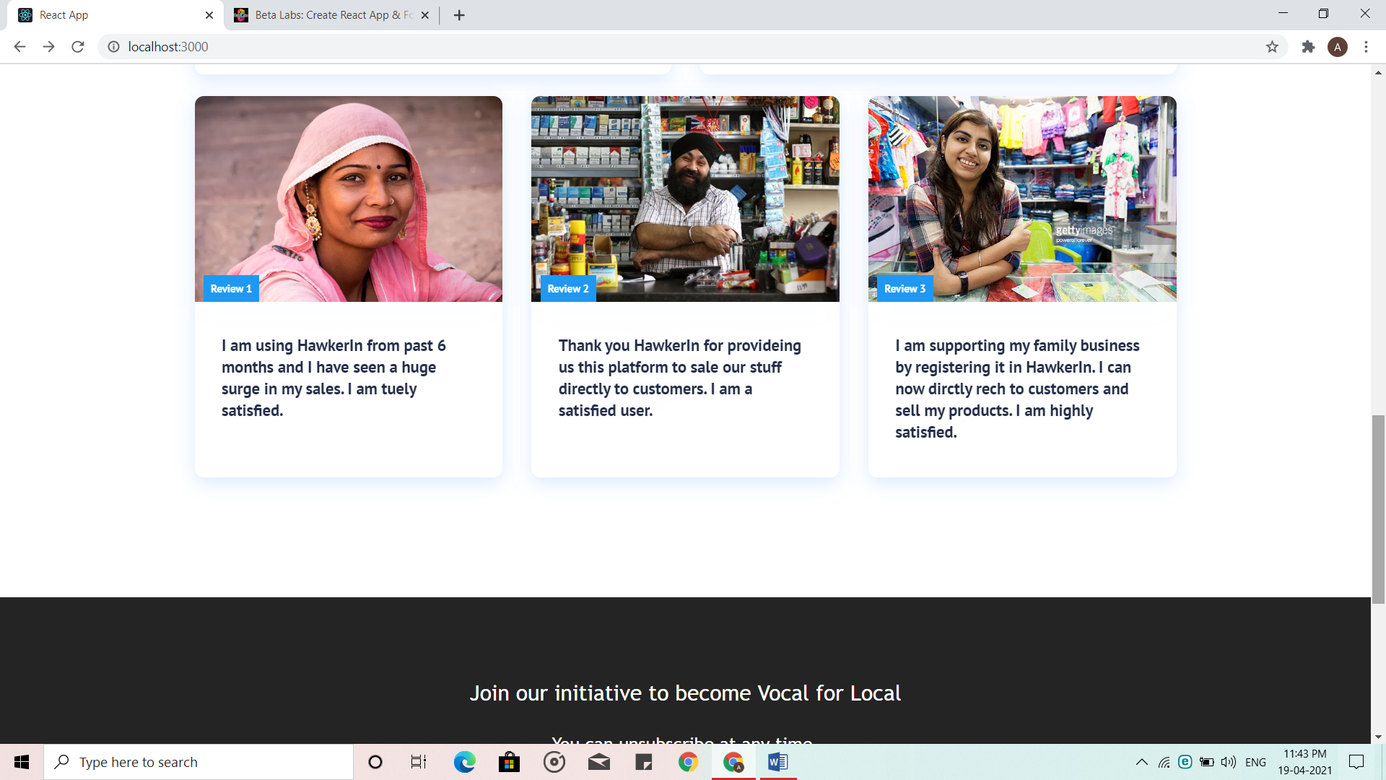
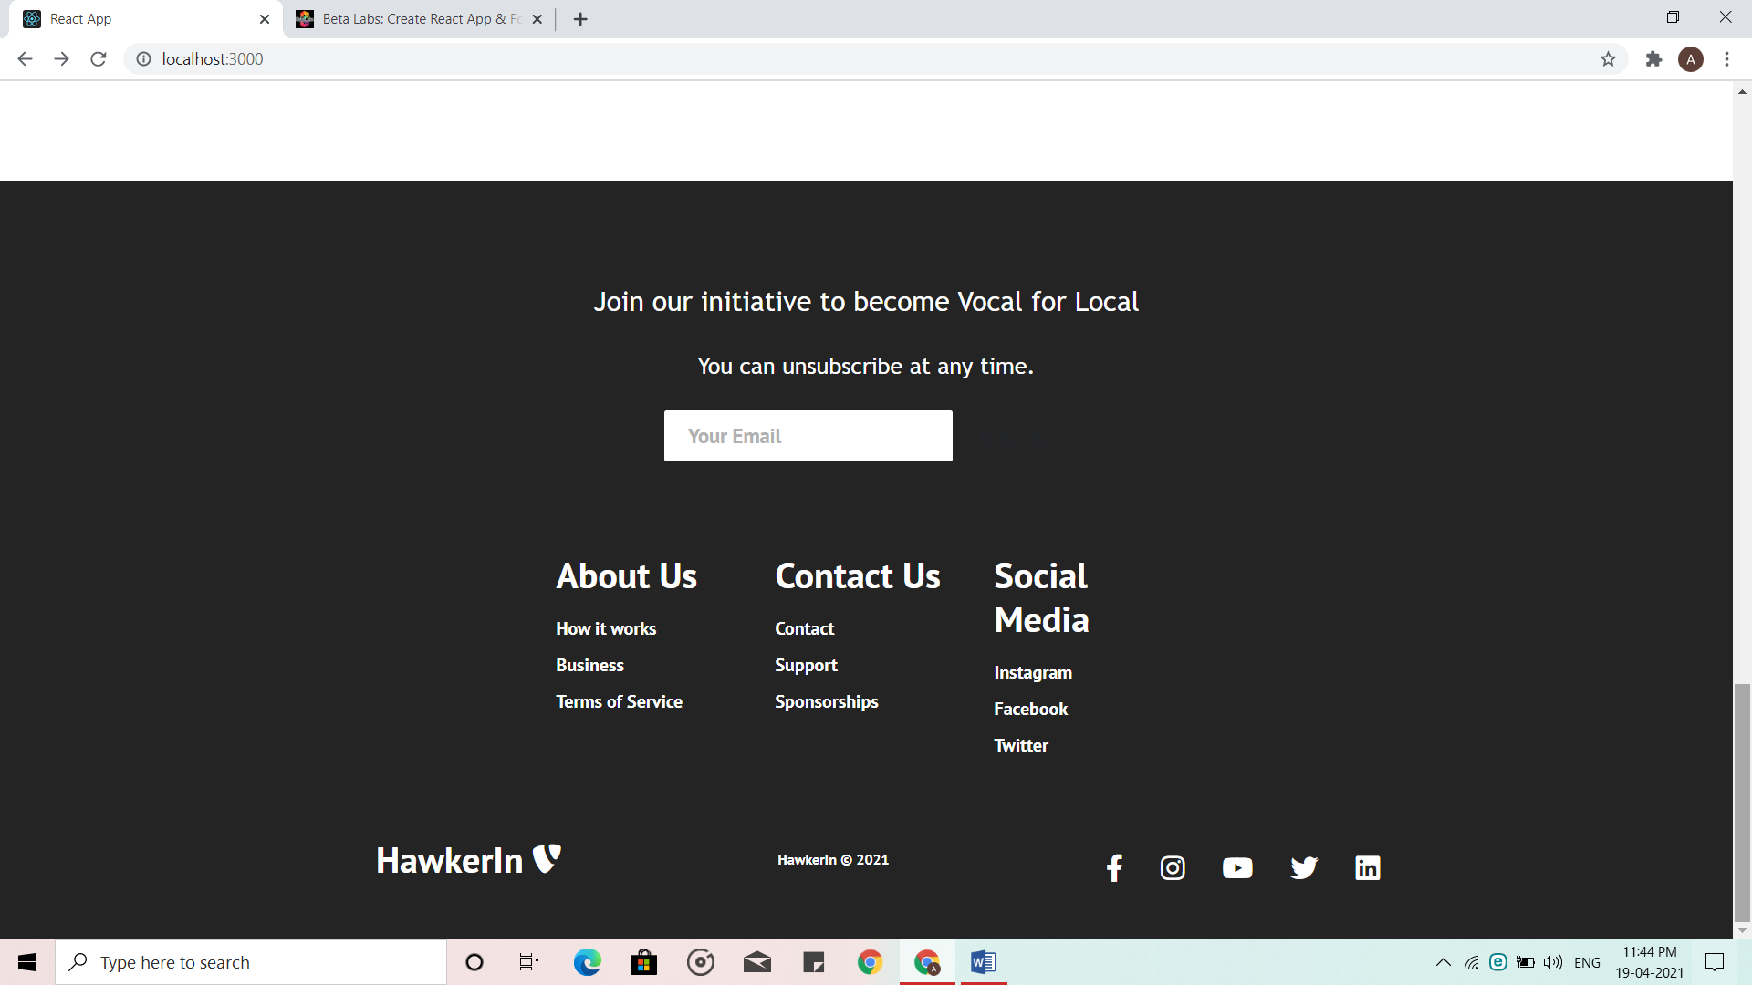
HOME PAGE
FOOTER

Slide 12
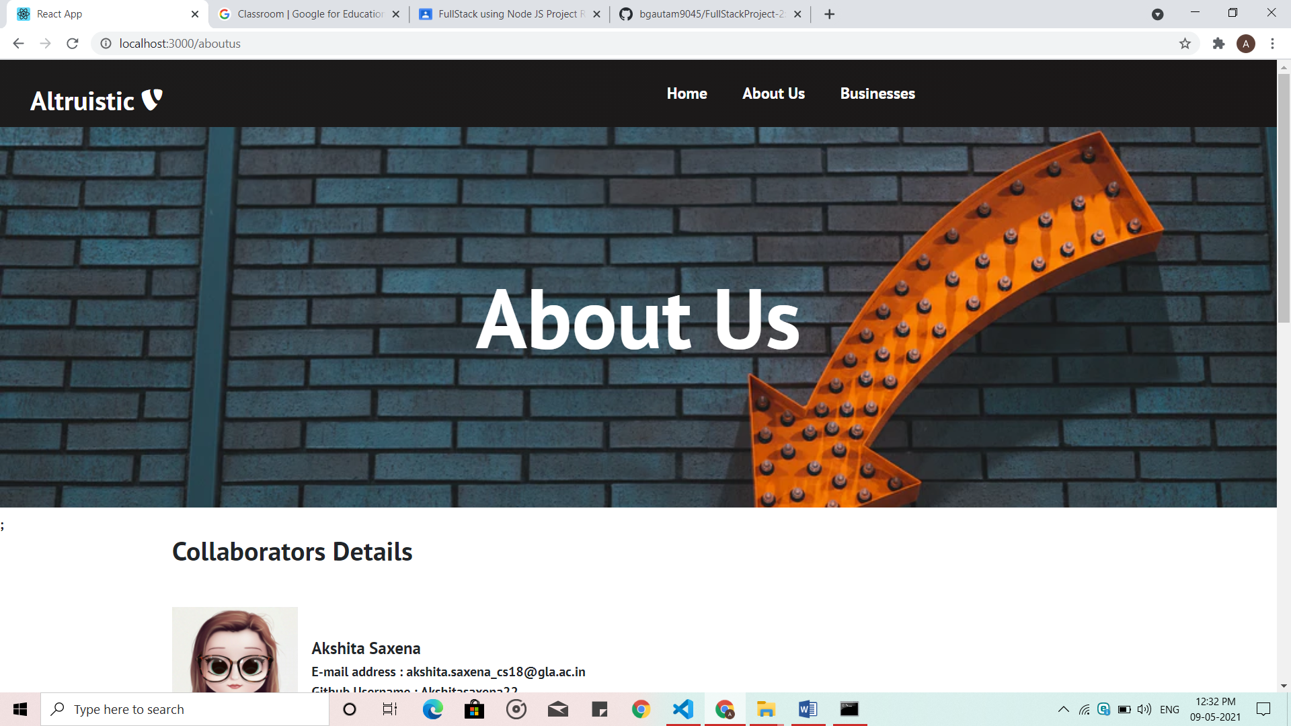
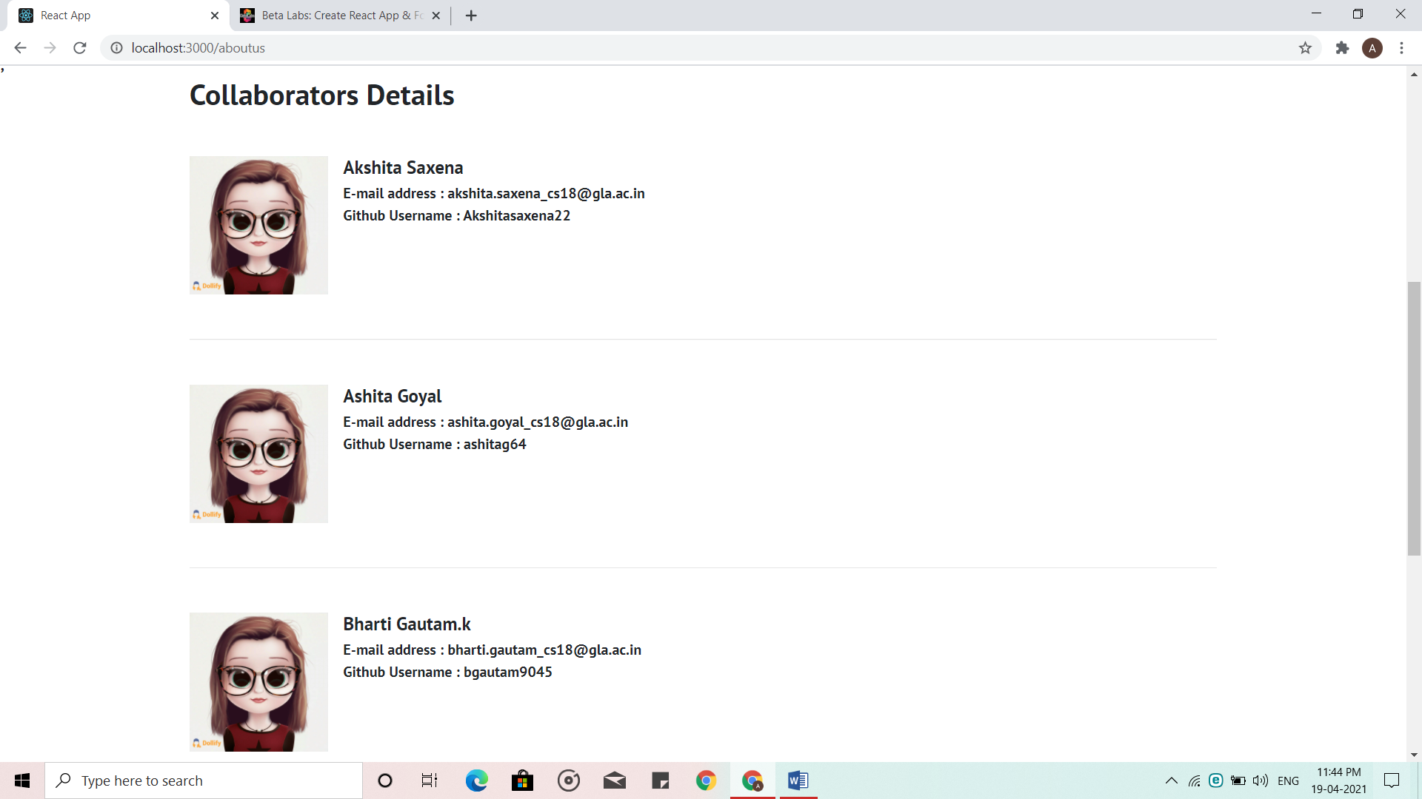
ABOUT US PAGE

Slide 13
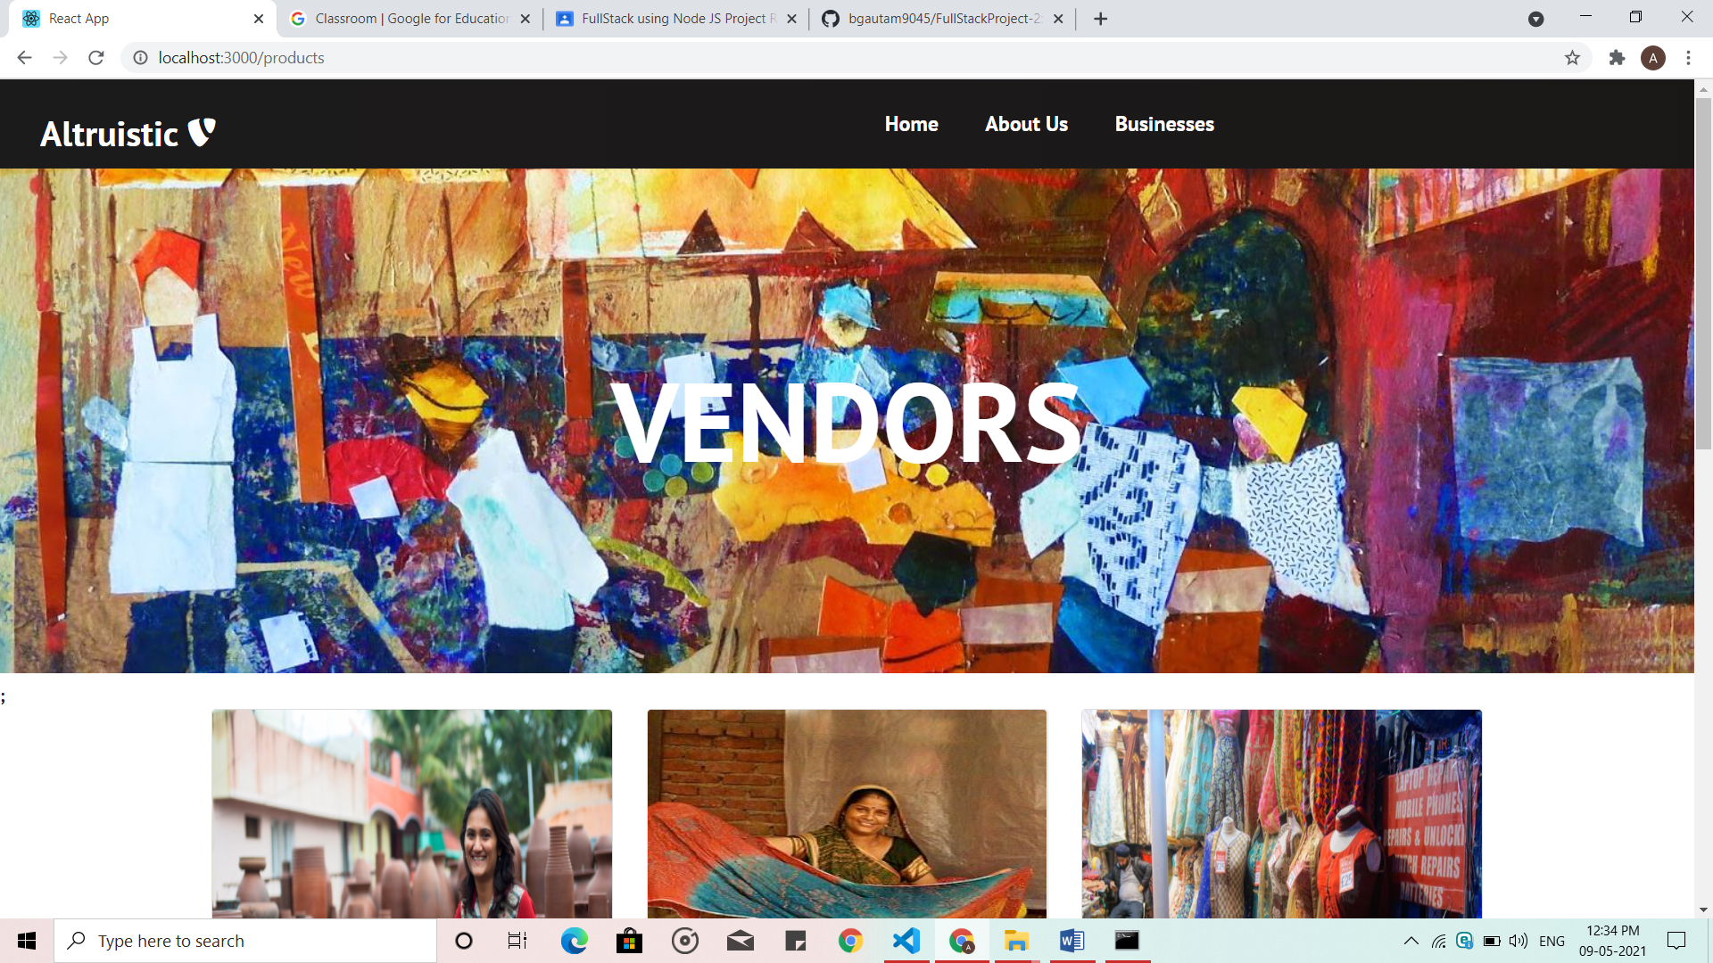
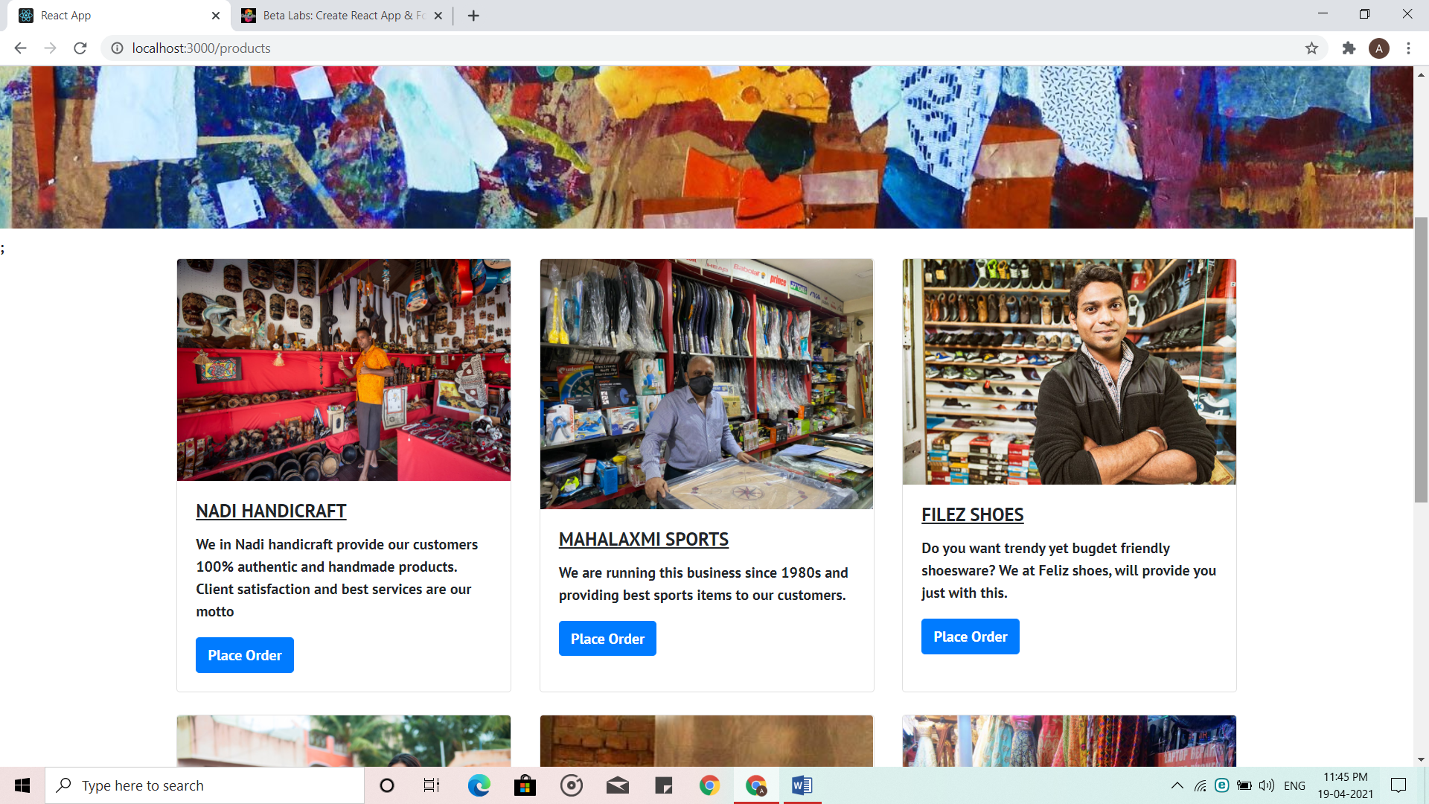
PRODUCTS PAGE

Slide 14
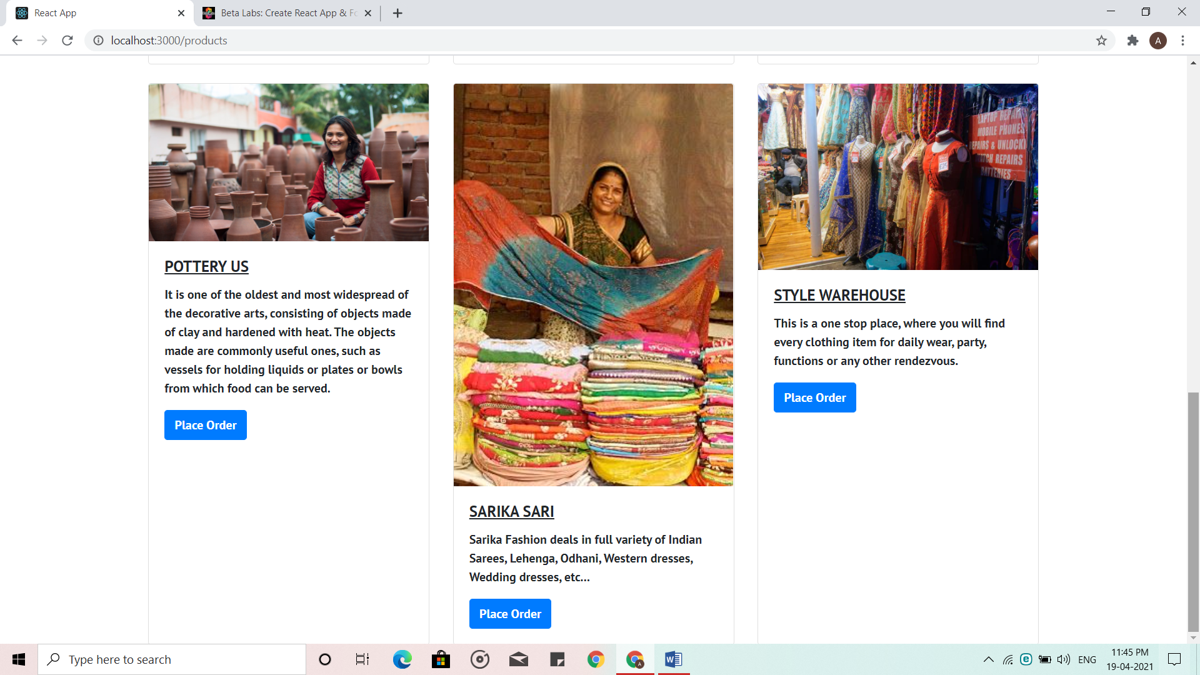
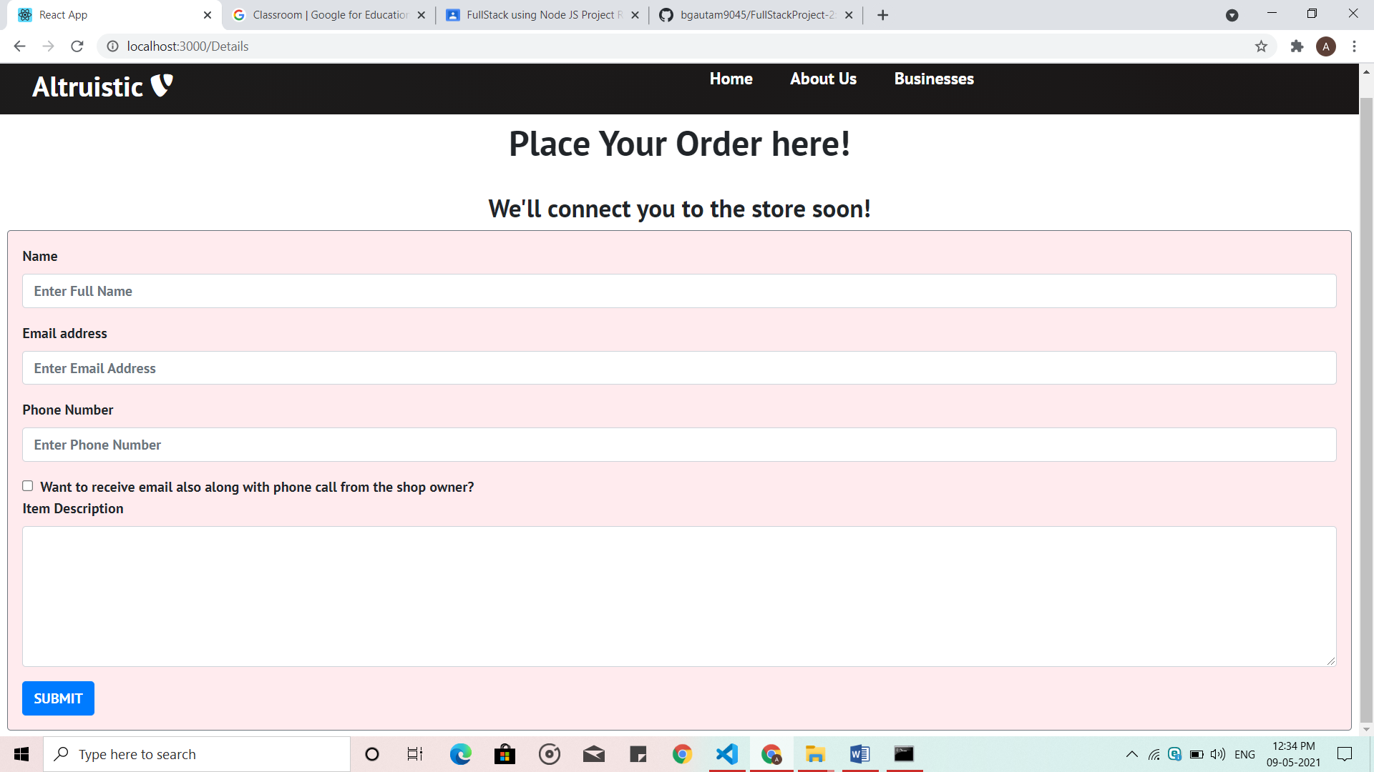
PRODUCTS PAGE
VENDOR DETAILS PAGE

Slide 15
Source code and Google Drive link
The source code of our project is available at the following link:
https://github.com/bgautam9045/FullStackProject-2.git
The Google Drive Link of our project is available at the following link:
https://drive.google.com/drive/folders/1ScC1N5kfpaCWCqseeqyMTXR8i1FBNJjx?usp=sharing

Slide 16
References
https://reactjs.org
www.w3schools.com
www.youtube.com
www.bootstrap.com
www.stackoverflow.com

Slide 17
THANK YOU !

